Slide 1
Relational Algebra

Slide 2
Formal Relational Query Languages
Two mathematical Query Languages form the basis for “real” languages (e.g. SQL), and for implementation:
  Relational Algebra: More operational, very useful for representing execution plans.
  Relational Calculus: Lets users describe what they want, rather than how to compute it. (Non-operational, declarative.)
A query is applied to relation instances, and the result of a query is also a relation instance.

Slide 3
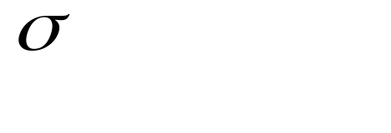
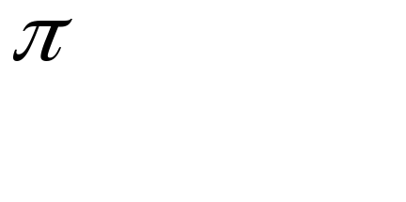



Relational Algebra
Basic operations:
  Selection ( ) Selects a subset of rows from relation.
  Projection ( ) Deletes unwanted columns from relation.
  Cross-product ( ) Allows us to combine two relations.
  Set-difference ( ) Tuples in reln. 1, but not in reln. 2.
  Union ( ) Tuples in reln. 1 and in reln. 2.
Additional operations:
  Intersection, join, division, renaming: Not essential, but (very!) useful.
The operators take one or two relations as inputs and produce a new relation as a result.
For set union and set difference, the two relations involved must be union-compatible—that is, the two relations must have the same set of attributes.
Notes:
6

Slide 4

Select Operation – Example
Selection (σ) - sigma
  unary operation written as
    {\sigma_{a \theta b}( R )
    is a binary operation in the set
    and are attributes
    Relation r
σ_{A=B ^ D > 5} (r)

Slide 5
Select Operation
Notation: σ _{p}(r)
p is called the selection predicate
Defined as:
σ_{p}(r) = {t | t ∈ r and p(t)}
Where p is a formula in propositional calculus consisting of terms connected by : ∧ (and), ∨ (or), ¬ (not)
Each term is one of:
<attribute> op <attribute> or <constant>
where op is one of: =, ≠, >, ≥. <. ≤
Example of selection:
σ _{dept_name=“Physics”}(instructor)

Slide 6

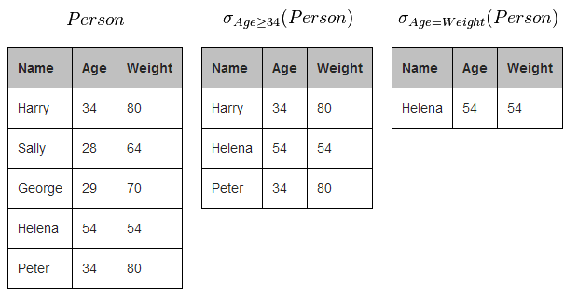
Selection Example

Slide 7

Project Operation
a projection is a unary operation
Notation:
where A₁, A₂ are attribute names and r is a relation name.
The result is defined as the relation of k columns obtained by erasing the columns that are not listed
Duplicate rows removed from result, since relations are sets
Example: To eliminate the dept_name attribute of instructor
∏_{ID, name, salary} (instructor)

Slide 8

Project Operation – Example
Relation r:
∏_{A,C} (r)

Slide 9
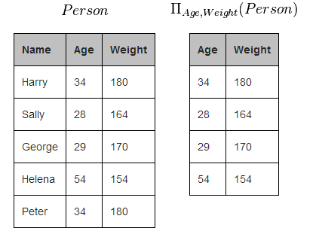
Projection Example

Slide 10
Example: Extended Projection
R = ( A B )
1 2
3 4
π_{A+B->C,A,A} (R) = C A1 A2
3 1 1
7 3 3

Slide 11
Rename Operation
A rename is a unary operation written as where:
  the result is identical to R except that the b attribute in all tuples is renamed to an a attribute
  \rho_{a/b}(R)
Allows us to name, and therefore to refer to, the results of relational-algebra expressions.
Allows us to refer to a relation by more than one name.
Formally the semantics of the rename operator is defined as follows:

Slide 12
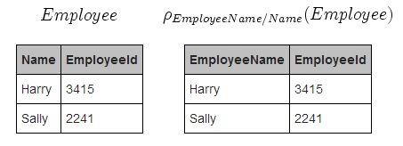
Rename Example

Slide 13

Rename Operation
Rho could also be used to rename a relation or the results of a relational expression which is a relation:
ρ _{x} (E)
returns the expression E under the name X
If a relational-algebra expression E has arity n, then
returns the result of expression E under the name X, and with the
attributes renamed to A₁ , A₂ , …., A_{n} .

Slide 14
Union Operation
Notation: r ∪ s
Defined as:
r ∪ s = {t | t ∈ r or t ∈ s}
For r ∪ s to be valid.
1. r, s must have the same arity (same number of attributes)
    union-compatible
2. The attribute domains must be compatible (example: 2nd column
of r deals with the same type of values as does the 2nd
column of s)
Example: to find all courses ids taught in the Fall 2009 semester, or in the Spring 2010 semester, or in both
∏_{course_id} (σ _{semester=“Fall” Λ year=2009} (section)) ∪
∏_{course_id} (σ _{semester=“Spring” Λ year=2010} (section))

Slide 15

Union Operation – Example
Relations r, s:
Union, intersection, and difference: the schemas of the two operands must be the same, so use that schema for the result.
r ∪ s:
For set union, set intersect and set difference, the two relations involved must be union-compatible
  that is, the two relations must have the same set of attributes.

Slide 16
Set Difference Operation
Notation r – s
Defined as:
r – s = {t | t ∈ r and t ∉ s}
Set differences must be taken between compatible relations.
  r and s must have the same arity (union-compatible )
  attribute domains of r and s must be compatible
Example: to find all courses taught in the Fall 2009 semester, but not in the Spring 2010 semester
∏_{course_id} (σ _{semester=“Fall” Λ year=2009} (section)) −
∏_{course_id} (σ _{semester=“Spring” Λ year=2010} (section))

Slide 17

Set difference of two relations
Relations r, s:
r – s:
For set union, set intersect and set difference, the two relations involved must be union-compatible
  that is, the two relations must have the same set of attributes.

Slide 18
Cartesian-Product Operation
Notation r x s
Defined as:
r x s = {t q | t ∈ r and q ∈ s}
Assume that attributes of r(R) and s(S) are disjoint.
  That is, R ∩ S = ∅
  No common attributes between R and S
If attributes of r(R) and s(S) are not disjoint, then renaming must be used.

Slide 19
Cartesian-Product Operation
R3 := R1 Χ R2
  Pair each tuple t1 of R1 with each tuple t2 of R2.
  Concatenation t1t2 is a tuple of R3.
  Schema of R3 is the attributes of R1 and then R2, in order.
  But beware attribute A of the same name in R1 and R2: use R1.A and R2.A.

Slide 20

Cartesian-Product Operation – Example
Relations r, s:
r x s:

Slide 21
Example: R3 := R1 Χ R2
R1( A, B )
1 2
3 4
R2( B, C )
5 6
7 8
9 10
R3( A, R1.B, R2.B, C )
1 2 5 6
1 2 7 8
1 2 9 10
3 4 5 6
3 4 7 8
3 4 9 10

Slide 22

Composition of Operations
Can build expressions using multiple operations
Example: σ_{A=C}(r x s)
r x s
σ_{A=C}(r x s)

Slide 23
Additional Operations
We define additional operations that do not add any power to the
relational algebra, but that simplify common queries.
Set intersection
Natural join
Assignment
Outer join

Slide 24
Set-Intersection Operation
Notation: r ∩ s
Defined as:
r ∩ s = { t | t ∈ r and t ∈ s }
Assume:
  r, s have the same arity
  attributes of r and s are compatible
Note: r ∩ s = r – (r – s)

Slide 25

Set-Intersection Operation – Example
Relation r, s:
r ∩ s

Slide 26
JOIN

Slide 27
Natural-Join Operation
Notation: r s
Let r and s be relations on schemas R and S respectively.
Then, r s is a relation on schema R ∪ S obtained as follows:
  Consider each pair of tuples t_{r} from r and t_{s} from s.
  If t_{r} and t_{s} have the same value on each of the attributes in R ∩ S, add a tuple t to the result, where
    t has the same value as t_{r} on r
    t has the same value as t_{s} on s
Example:
  R = (A, B, C, D)
  S = (E, B, D)
  Result schema = (A, B, C, D, E)
  r s is defined as:
  ∏_{r.A, r.B, r.C, r.D, s.E} (σ_{r.B = s.B ∧ r.D = s.D} (r x s))

Slide 28

Natural Join Example
Relations r, s:
r s

Slide 29
Natural Join
Natural join is associative
  (instructor teaches) course is equivalent to
  instructor (teaches course)
Natural join is commutative
  instruct teaches is equivalent to
  teaches instructor

Slide 30
Theta-Join
R3 := R1 ⋈_{C} R2
  Take the product R1 Χ R2.
  Then apply σ_{C} to the result.
As for σ, C can be any boolean-valued condition.
The theta join operation r _{θ} s is defined as
  r _{θ} s = σ_{θ} (r x s)
  Where θ (theta) is one of the comparison operators:
    {=, <, ≤, >, ≥, ≠}

Slide 31
Example: Theta Join
Sells( shop, fruit, price ) shops( name, addr )
Joe’s ajua 2.50 Joe’s Maple St.
Joe’s apples 2.75 Sue’s River Rd.
Sue’s ajua 2.50
Sue’s Coors 3.00
ShopInfo := Sells ⋈_{Sells.shop = Shops.name} shops
ShopInfo( shop, fruit, price, name, addr )
Joe’s ajua 2.50 Joe’s Maple St.
Joe’s apples 2.75 Joe’s Maple St.
Sue’s ajua 2.50 Sue’s River Rd.
Sue’s Banana 3.00 Sue’s River Rd.

Slide 32
Outer Join
An extension of the join operation that avoids loss of information.
Computes the join and then adds tuples form one relation that does not match tuples in the other relation to the result of the join.
Uses null values:
  null signifies that the value is unknown or does not exist
  All comparisons involving null are (roughly speaking) false by definition.
    We shall study precise meaning of comparisons with nulls later

Slide 33
Outer Join – Example
Relation instructor1
ID
name
dept_name
10101
12121
15151
Srinivasan
Wu
Mozart
Comp. Sci.
Finance
Music
Relation teaches1
ID
course_id
10101
12121
76766
CS-101
FIN-201
BIO-101

Slide 34
Outer Join – Example
Join
instructor teaches
ID
name
dept_name
course_id
10101
12121
Srinivasan
Wu
Comp. Sci.
Finance
CS-101
FIN-201
Left Outer Join
instructor teaches
ID
name
dept_name
course_id
10101
12121
15151
Srinivasan
Wu
Mozart
Comp. Sci.
Finance
Music
CS-101
FIN-201
null

Slide 35
Outer Join – Example
Right Outer Join
instructor teaches
ID
name
dept_name
course_id
10101
12121
76766
Srinivasan
Wu
null
Comp. Sci.
Finance
null
CS-101
FIN-201
BIO-101
Full Outer Join
instructor teaches
ID
name
dept_name
course_id
10101
12121
15151
76766
Srinivasan
Wu
Mozart
null
Comp. Sci.
Finance
Music
null
CS-101
FIN-201
null
BIO-101

Slide 36
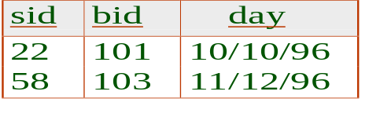
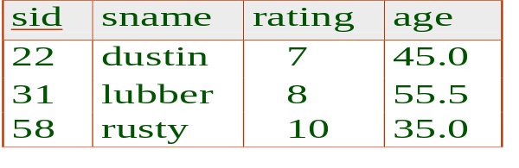
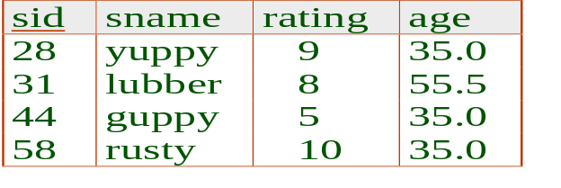
Example Instances
R1
S1
S2

Slide 37

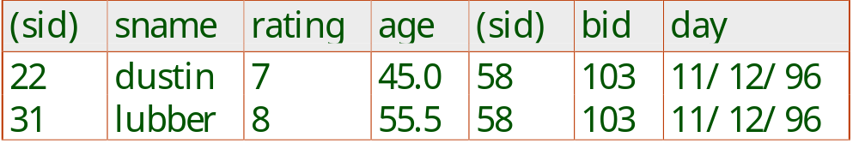
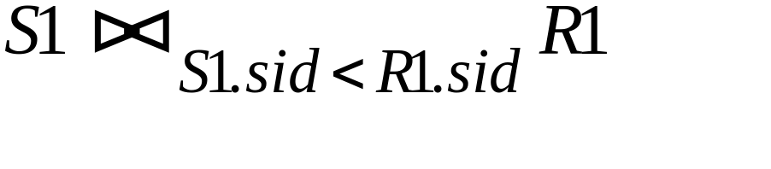
Condition Joins
Condition Join:
Result schema same as that of cross-product.
Fewer tuples than cross-product, might be able to compute more efficiently
Sometimes called a theta-join.
Notes:
11

Slide 38
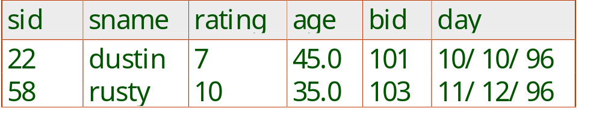
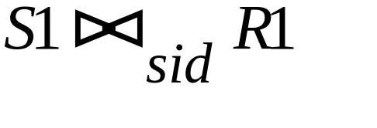
Other Joins
Equi-Join: A special case of condition join where the condition c contains only equalities.
Result schema similar to cross-product, but only one copy of fields for which equality is specified.
Natural Join: Equijoin on all common fields.
Notes:
12

Slide 39
Extended Relational-Algebra-Operations
Generalized Projection
Aggregate Functions

Slide 40
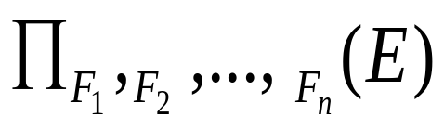
Generalized Projection
Extends the projection operation by allowing arithmetic functions to be used in the projection list.
E is any relational-algebra expression
Each of F₁, F₂, …, F_{n} are are arithmetic expressions involving constants and attributes in the schema of E.
Given relation instructor(ID, name, dept_name, salary) where salary is annual salary, get the same information but with monthly salary
∏_{ID, name, dept_name, salary/12} (instructor)

Slide 41


Aggregate Functions and Operations
Aggregation function takes a collection of values and returns a single value as a result.
avg: average value
min: minimum value
max: maximum value
sum: sum of values
count: number of values
Aggregate operation in relational algebra
E is any relational-algebra expression
  G₁, G₂ …, G_{n} is a list of attributes on which to group (can be empty)
  Each F_{i} is an aggregate function
  Each A_{i} is an attribute name
Note: Some books/articles use γ instead of (Calligraphic G)

Slide 42

Aggregate Operation – Example
Relation r:
A
B
C
α
α
β
β
α
β
β
β
7
7
3
10
_{sum(c)} (r)
sum(c )
27

Slide 43


Aggregate Operation – Example
Find the average salary in each department
_{dept_name} _{avg(salary)} (instructor)
avg_salary

Slide 44
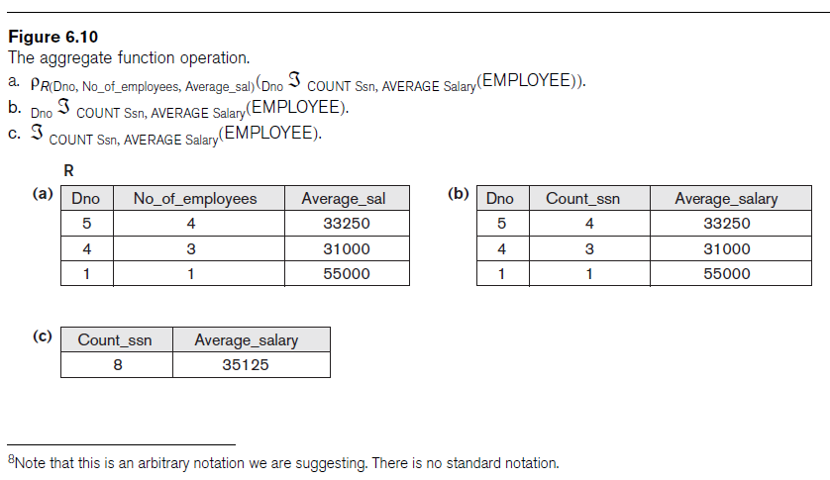
Examples

Slide 45
Schemas for Results
Union, intersection, and difference:
  the schemas of the two operands must be the same, so use that schema for the result.
Selection:
  schema of the result is the same as the schema of the operand.
Projection:
  list of attributes tells us the schema.
Product:
  schema is the attributes of both relations.
    Use R.A, etc., to distinguish two attributes named A.
Theta-join: same as product.
Natural join: union of the attributes of the two relations.
Renaming: the operator tells the schema.

Slide 46
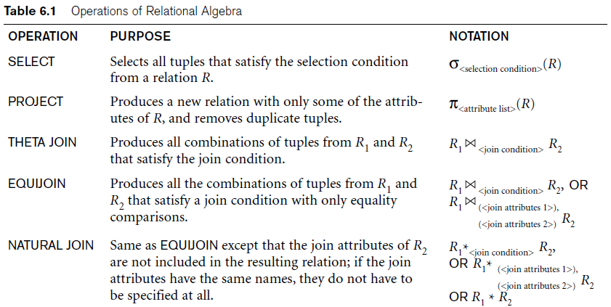
Operations of Relational Algebra

Slide 47
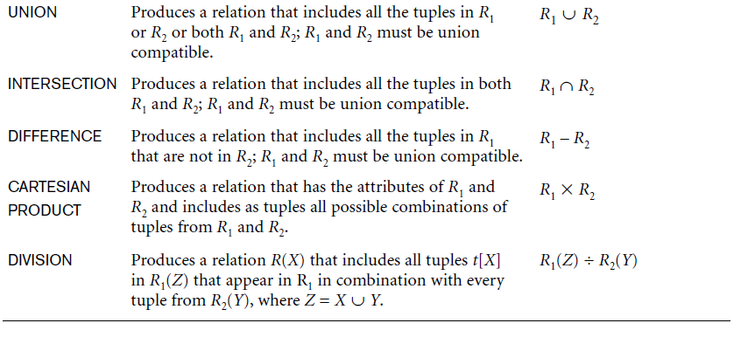
Operations of Relational Algebra (cont’d.)

